Slide 1
Health Level 7 and Healthcare Interoperability
December 26, 2023

Slide 2
Course plan
Lecture 2: History & Importance of HL7 Standards
Lecture 3: Understanding HL7 Message Structure
Lecture 4: HL7 in Action & Healthcare Interfaces
Lecture 6:
Case Study & Recommended Readings
Lecture 1: Introduction to Healthcare Interoperability
Lecture 5:
Implementing an HL7 Interface

Slide 3
Lecture 1: Introduction to Healthcare Interoperability

Slide 4


Why do we need to move data between systems in Healthcare

Slide 5
Common Scenarios for healthcare Data Exchange
Scenario 1:
Patient Transfers - Sharing essential medical information when a patient moves between healthcare facilities.
Scenario 2:
Lab Results Sharing - Seamless exchange of diagnostic results between different laboratory systems.
Scenario 3:
Referral Information - Efficient transfer of patient referral data between primary care and specialists.

Slide 6
Healthcare is full of reasons we might want to move data around:
Transmit a clinical order from requester to fulfiller
Return the fulfillment back to the requester
Share a list of allergies for a given patient
Create a referral to a specialist
Report metrics to government

Slide 7
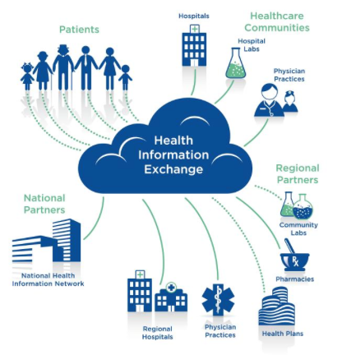
Importance of Data Exchange in Healthcare
Improved patient care and outcomes
Efficiency and cost savings in healthcare processes
Better informed clinical decisions and treatments

Slide 8
What is Interoperability in context of healthcare IT?
Capability of different IT systems and software applications to communicate, exchange data, and use the information that has been exchanged effectively.
It involves the ability to share and access patient data across different healthcare settings, allowing for coordinated care, improved patient outcomes, and more efficient healthcare services.
Three Levels of Interoperability:
Foundational
Structural
Semantic
Notes:
Foundational Interoperability:
This level allows data exchange from one information system to another without requiring the ability for the receiving information system to interpret the data.
Structural Interoperability:
At this level, the data exchange between information systems is interpretable at the data field level. The structure or format of the data exchange is such that the clinical or operational purpose and meaning of the data are preserved and unaltered.
Semantic Interoperability:
This is the highest level, where two or more systems or elements can exchange information and interpret that shared data. This includes the ability to automatically interpret the information exchanged meaningfully and accurately to produce useful results as defined by the end users of both systems.

Slide 9
Challenges in Interoperability
Lack of Standardization: Absence of uniform data formats and protocols.
Complex Healthcare Ecosystem: Involvement of various systems with different technologies and legacy systems.
Privacy and Security Concerns: Balancing data accessibility with patient confidentiality and security measures.

Slide 10
Summary of Healthcare Interoperability
1
2
3
Healthcare interoperability plays a crucial role in enabling seamless data exchange across various healthcare systems and entities.
The key to improved patient care and outcomes lies in the efficient exchange and use of healthcare data.
Despite the benefits, healthcare interoperability faces challenges such as technical barriers, data security concerns, and lack of standardization.

Slide 11
Lecture 2: History & Importance of HL7 Standards

Slide 12
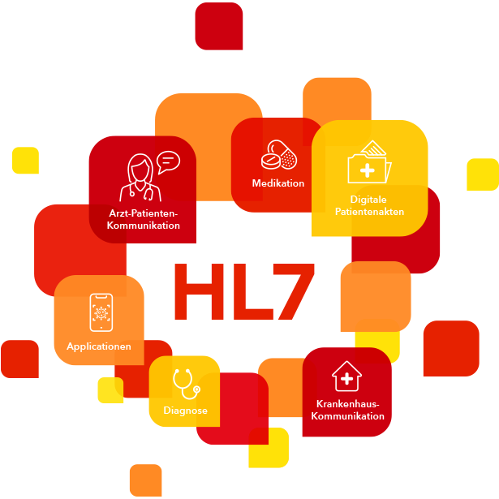
Basics of HL7 Standards
Key Points
Introduction and history of HL7
Role of HL7 in healthcare data exchange
Overview of v2.x, v3, and FHIR
Real-world relevance and examples of HL7 standards

Slide 13
What is HL7?
HL7 is a set of international standards for clinical data interchange in healthcare.
It stands for Health Level Seven and is named after the seventh layer of the ISO OSI Reference Model.
HL7 addresses the need for reliable and efficient data exchange between healthcare applications.

Slide 14
HL7 - Brief History
Founded as an ANSI accredited international standards development organization in 1987 to promote communication between hospital data systems and electronic health information
Stated a goal of creating a platform independent method of moving data between different systems
Developed grammar for messaging and standardized vocabulary
The “7” in HL7 refers to the ‘application level’ of the OSI model—on which HL7 focuses.

Slide 15
HL7 - The Primary Standard for Communicating Health Data
HL7 is a set of standards for transferring clinical and administrative data between hospital information systems. It’s like a language that describes you, and your medical information, to all the Hospital information systems.
ANSI Standard for clinical interoperability
HL7 standards are widely adopted and continue to evolve
Meaningful Use has identified a number of HL7 standards to support sharing data between systems
HL7 website: http://www.hl7.org/

Slide 16
Purpose of HL7
HL7 plays a crucial role in standardizing healthcare data formats and protocols for interoperability.
The purpose of HL7 is to define the structure and exchange formats of electronic health information, ensuring compatibility between different healthcare systems.
HL7 supports seamless data exchange for clinical workflows, administrative processes, and public health reporting.

Slide 17
HL7 CATEGORIES
01
02
03
04
05
06
07
Our focus
PRIMARY STANDARDS
CLINICAL &
ADMINISTRATIVE DOMAINS
FOUNDATIONAL STANDARDS
Integral and popular standards
Fundamental tools
Clinical specialty standards
EHR PROFILES
RULES & REFERENCES
EDUCATION & AWARENESS
IMPLEMENTATION GUIDES
Enabling constructs for EHRs
Supplemental documentation
Technical specifications
Resources for supplemental understanding
Notes:
•HL7 organizes their standards, resources, and other documents in to the following seven categories:
•Primary Standards: integral and popular standards
•Foundational Standards: fundamental tools
•Clinical and Administrative Domains: clinical specialty standards
•EHR Profiles: enabling constructs for EHRs
•Implementation Guides: supplemental documentation
•Rules and References: technical specifications
•Education and Awareness: resources for supplemental understanding

Slide 18
Versions of HL7
HL7 v2.x: The most widely used version, known for its messaging format and data exchange standards in healthcare.
HL7 v3: Introduces a more comprehensive reference information model and focuses on interoperability at a broader level.
FHIR (Fast Healthcare Interoperability Resources): The latest version, designed for web standards, with a focus on easy implementation and support for modern technologies.

Slide 19
1989
2003
HL7 version 2.x messaging
•HL7 version 3 messaging
H L 7
V E R S I O N S
TIMELINE
2005
•HL7 Clinical Document Architecture (CDA)
2014
•HL7 Fast Healthcare Interoperability Resources (FHIR)

Slide 20








HL7 Version 2 History
v.2.x
Previous Versions
HL7 Version 2 first published in 1989
Each version of Version 2 builds on the previous versions with a better data model and stronger vocabulary standards
The Normative Version specifications have evolved
The current Normative Version is Version 2.7
New versions are intended to allow backward compatibility
v.2.3
Mostly used
v.2.7
Normative
v.2.9
Latest

Slide 21
V3 and V2.x are not compatible with each other…
 | BENEFITS | DRAWBACKS
HL7 V2 | “Looser” guidelines, can be built in an ad-hoc fashion, backwards compatible between other V2 versions, not “plug-and-play ,” but flexible on how interfaces are developed | Loose guidelines can lead to discrepancies, lacking consistency in application data models, vendors may not have updated to latest version of V2.x yet, not compatible with V3
HL7 V3 | Standards are stricter and more consistent, guidelines are clear and concise with less variation permitted, “plug-and-play”, built upon Reference Information Model (RIM) | Not compatible with V2.x, cost, training and resources needed for adoption, will still need to concurrently maintain any V2 systems

Slide 22
Summary of HL7 Basics
HL7 is a crucial standard for healthcare data exchange.
1
It has different versions, including v2.x, v3, and FHIR.
2
HL7 defines the structure, content, and context of health-related data.
3

Slide 23
Q&A: HL7 Basics
What are some real-world examples of HL7 implementation in healthcare settings?
How has the introduction of FHIR impacted data exchange in healthcare?
What are the key differences between HL7 v2.x and v3?

Slide 24
Lecture 3: Understanding HL7 Message Structure

Slide 25
HL7 messages are standardized text strings used to exchange information between different healthcare systems, like Electronic Medical Records (EMR), laboratories, and billing software.

Slide 26
Hl7 Message Anatomy
Message Type
Segment
Field
Message types (categories like ADT, ORM, etc.) define the purpose of an HL7 message and dictate which segments and in what sequence they should appear. They're like the subject of a conversation, indicating what the message is about
Each HL7 message is made up of segments. Each segment begins with a 3-letter code (like MSH or PID) that identifies its type and contains specific healthcare information. Segments are like sentences in a message.
Each segment contains fields, separated by a delimiter (like '|'). Fields hold individual pieces of information, such as patient name, ID, or test results. Fields are like words in a sentence

Slide 27
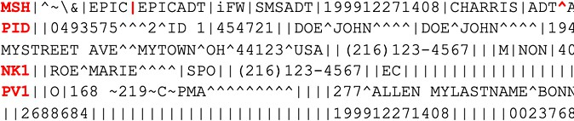
Understanding HL7 Message Structure
An HL7 message is divided into segments, each serving a specific purpose in the message. Segments are the “sentences” of the message
Each segment is further divided into fields, which contain the actual data or information.
Fields are made up of components, subcomponents, and repeating fields, offering a high level of data granularity.
Fields are separated by delimiters (ASCII characters or XML tags). Fields may be optional, repeat, or both. Empty fields have place holders. Each field has a data type specification
Segment
Field
Sample HL7 Message

Slide 28
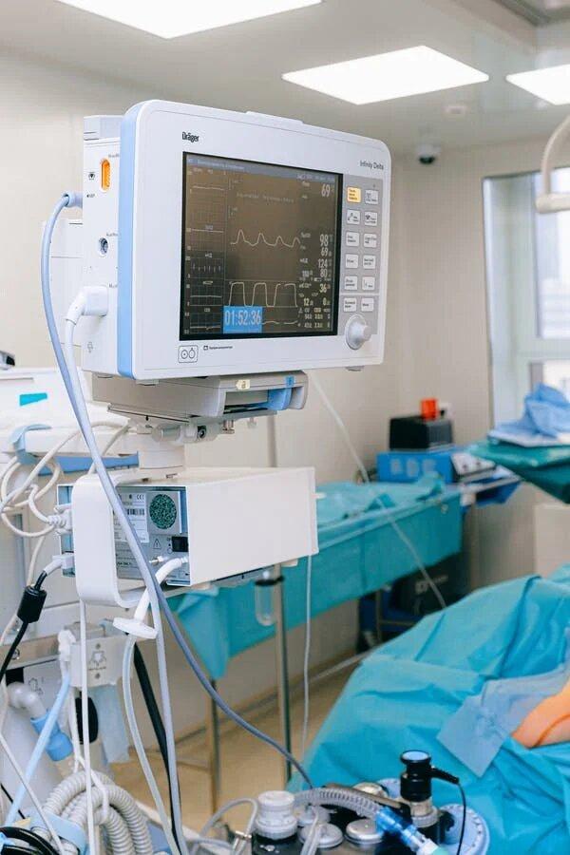
Reading an HL7 Message
Key Elements of an HL7 Message
The message begins with a header that contains metadata and control information.
Each segment within the message serves a specific purpose, such as patient identification or diagnostic information.
Segments are made up of one or more fields, each carrying a different data element.
Fields are further divided into components, subcomponents, and repeating fields, providing a high level of data granularity.

Slide 29
Common Message Types
ADT (Admit, Discharge, Transfer) messages for patient registration and movement tracking.
ORM (Order) messages for requesting services such as lab tests, and procedures.
ORU (Observation Result) messages for communicating clinical observations and results.

Slide 30


HL7 Version 2 - Commonly used Message Segments
DG1 – Diagnosis EVN – Event type GT1 – Guarantor IN1 – Insurance
MSH – Message header
NK1 – Next of kin/associated parties NTE – Notes and comments
OBR – Observation request
OBX – Observation result ORC – Common order
PID – Patient identification
FT1 (for DFT messages) – Financial transaction

Slide 31
Building Blocks of Messages
The message header contains routing information and message metadata.
1
The message body carries the actual data or instructions, organized into segments.
2
Each segment is made up of fields, which in turn contain components and subcomponents, forming a hierarchical structure.
3

Slide 32
Lecture 4: HL7 in ACTION & HEALTHCARE INTERFACES

Slide 33
HL7 in Action
Patient Registration (ADT^A04 message):
When a patient is registered at a clinic or hospital, an HL7 ADT (Admit, Discharge, Transfer) message is generated to communicate the patient's demographic information to different departments and systems. This message ensures that the patient's information is consistent and available across the entire organization.
Appointment Scheduling (SIU^S12 message):
HL7 messages are used to schedule, reschedule, or cancel patient appointments. The SIU (Scheduling Information Unsolicited) message is sent from the scheduling system to other clinical systems to update them about the patient’s appointment status.
Laboratory Order Entry (ORM^O01 message):
When a physician orders a lab test, an HL7 ORM (Order Entry) message is sent from the ordering system (like an EMR) to the laboratory information system (LIS) to request the test and provide necessary patient information.

Slide 34
HL7 in Action
Laboratory Results Reporting (ORU^R01 message):
Once the lab test is completed, the results are sent back to the ordering physician or system via an HL7 ORU (Observation Result Unsolicited) message. This message communicates the findings from the laboratory back to the EMR for review.
Pharmacy Dispense Information (RDE^O11 message):
HL7 messages are used to transmit prescription information from the EMR to the pharmacy system. The RDE (Pharmacy/Treatment Encoded Order) message includes details about the medication prescribed, dosage, and administration instructions.
Radiology Information Systems (RIS) (ORM^O01 message):
Similar to lab orders, when imaging studies like X-rays or MRIs are ordered, HL7 ORM messages are used to send orders from the EMR to the RIS. The results and images are later attached to the patient's electronic record.

Slide 35
Key Areas of Interoperability
Clinical Non-Clinical
Medical Device Integration (MDI)
Transcription/Dictation
PACS & Specialty Imaging
Biometrics
Clinical Content & Order Sets
Patient Engagement Systems
Medication Dispensing
Billing & Financial Systems
Nutrition System
Provincial Systems – Clinical & Non Clinical

Slide 36
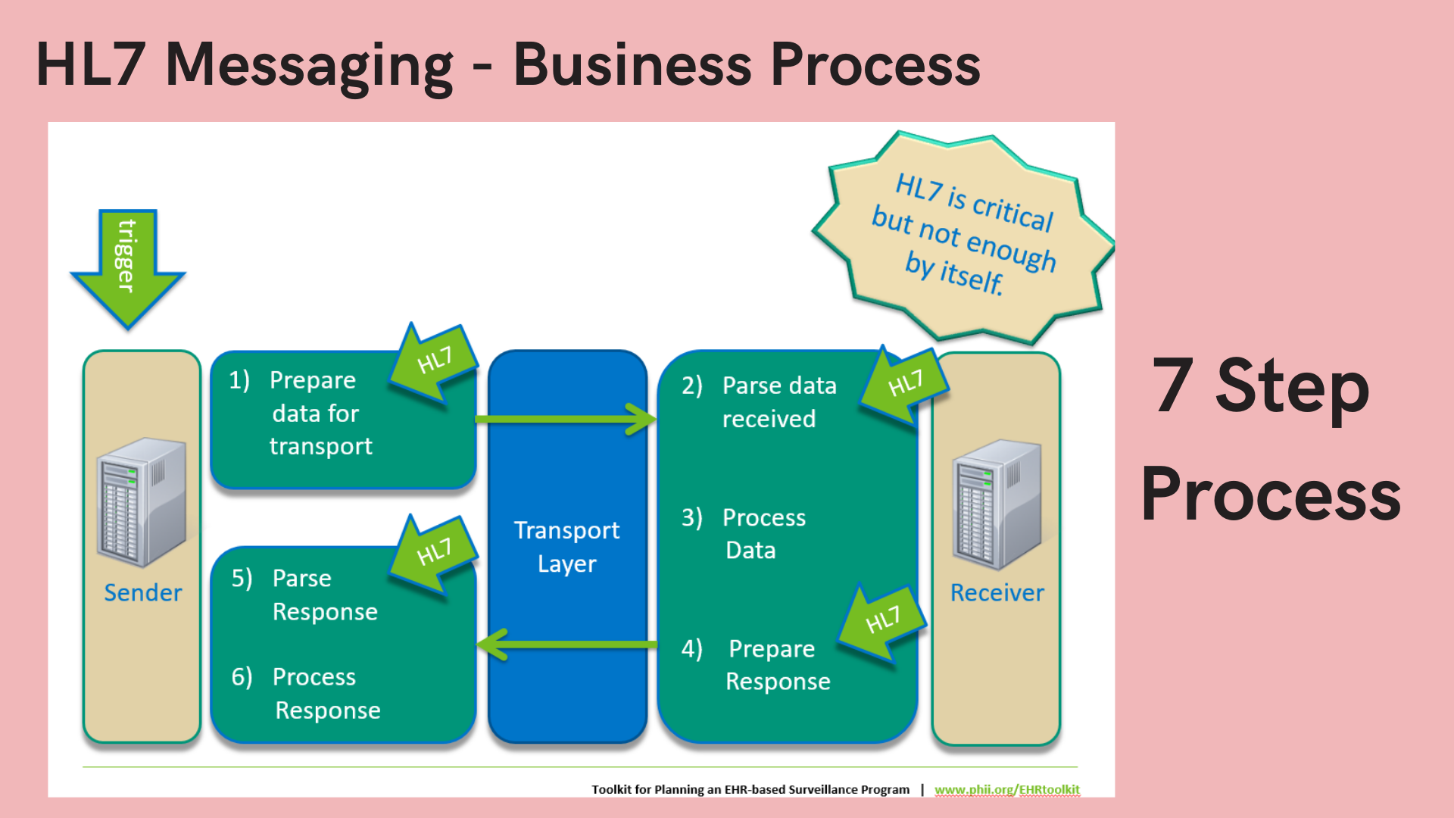

Slide 37
INTEROPERABILITY & EMR

Slide 38
What is an Electronic Medical Record (EMR)
An electronic medical record (EMR) is a digital version of a patient’s paper chart. EMRs are real-time, patient-centered records that make information available instantly and securely to authorized users.
Source: U.S. Department of Health and Human Services' Office of the National Coordinator for Health Information Technology (ONC)

Slide 39
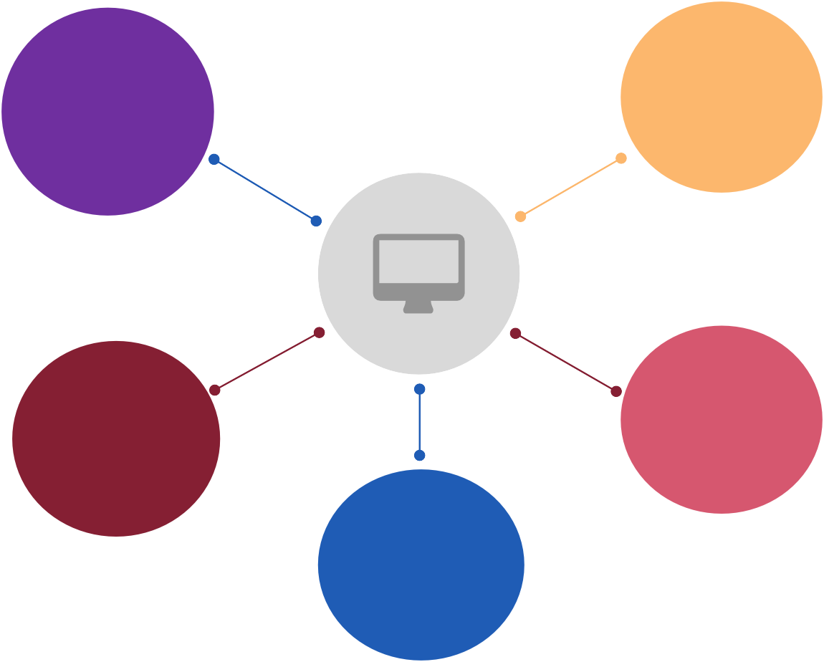
Electronic Medical Records – Key Components
Inpatient, Ambulatory & ED clinical systems for all users with base HIS functions like CPOE, EMPI, MAR etc.
Core Clinical
Integration &
Mobility
Clinical Specialty
Clinical
specialty
& support
ancillary specific
Solutions which can support internal & external interoperability with HIS and enable seamless mobility
applications to
workflows & reporting requirements
EMR
Includes patient portal and bedside patient engagement solutions
Operations &
Finance
Applications supporting hospital operations such as ADT, HIM as well as Revenue Cycle Management
Patient Engagement
Research & Analytics
Research & population health related applications and analytics solutions available for all users

Slide 40
Types of Interfaces
EMR systems typically have two types of interfaces: inbound and outbound.
Inbound interfaces allow data to be imported into the EMR system from other systems. For example, an inbound interface might be used to import lab results from a laboratory information system into a hospital's electronic health record (EHR) system
Outbound interfaces allow data to be exported from the EMR system to other systems. For example, an outbound interface might be used to export medication orders from an EHR system to a pharmacy information system.

Slide 41
Epic Interface Handling and Monitoring
Care Everywhere:
Epic's Care Everywhere platform facilitates the exchange of patient data across healthcare institutions, including Health Information Exchanges (HIEs) and government agencies, without an intermediary, using industry-standard transactions and terminology.
APIs and Web Services:
Epic provides a service-oriented architecture (SOA) platform, Interconnect, which exposes services as SOAP/XML and REST/XML/JSON over HTTP/S. This supports both traditional messaging and asynchronous, queued messaging.
FHIR Support:
Epic supports a range of FHIR read, search, and write resources and is continuously updating support for new resources and standards.
Standard Point-to-Point Interfaces:
Epic maintains a large library of standard interfaces supporting HL7 v2 and v3, NCPDP, CDA, ANSI, DICOM, and more, allowing connectivity with various vendors and external groups.
Bridges Interface Toolkit:
Epic offers the Bridges toolkit for customers to monitor, maintain, and develop new interfaces as per their specific needs

Slide 42
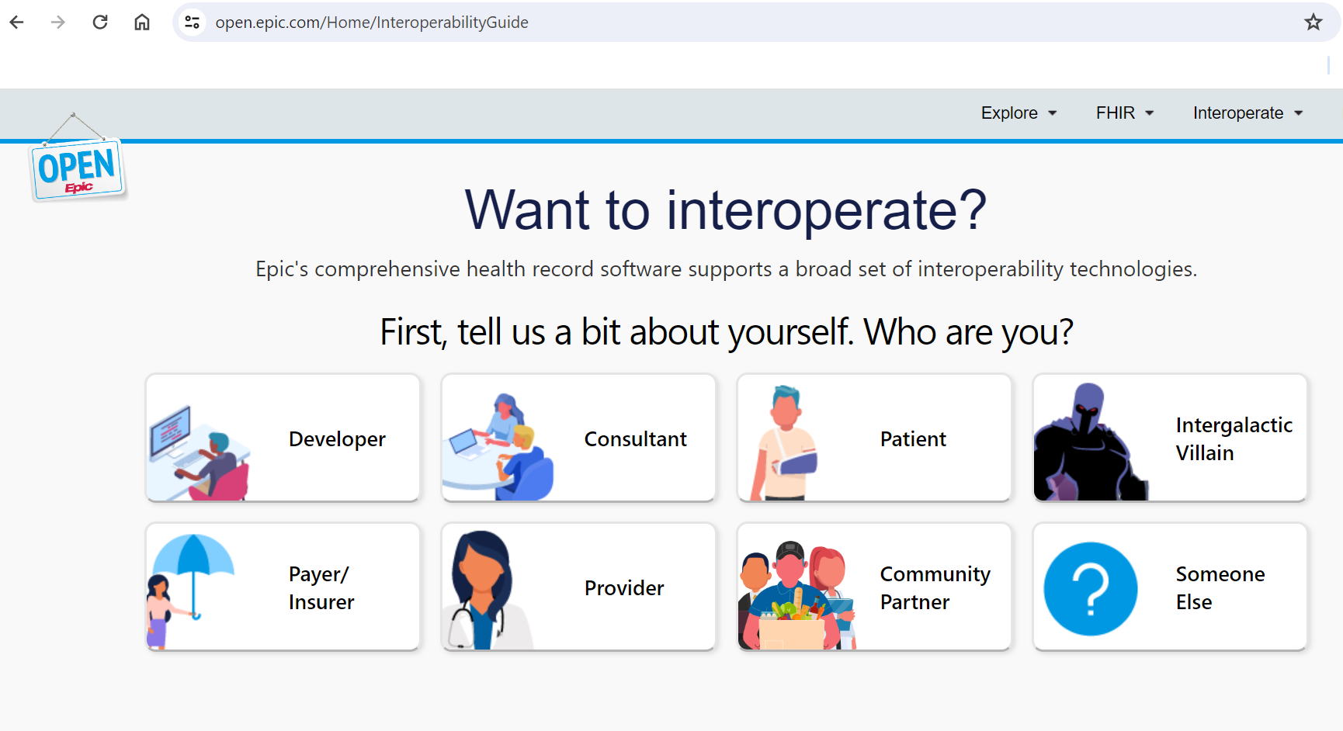
Open EPIC

Slide 43
Cerner Interface Handling and Monitoring:
Cerner Open Engine:
Cerner's integration engine that facilitates data exchange between Cerner and external systems using various protocols and standards, including HL7.
Real-Time Monitoring:
Interface monitoring tools that provide real-time insight into the status of messages being processed, helping to quickly identify and address issues.
Comprehensive Logging:
Detailed logging of transactions and message histories for auditing purposes and to facilitate troubleshooting.
Custom Interface Development:
Cerner allows for the creation of custom interfaces to meet the specific data exchange needs of healthcare organizations.
Security and Compliance:
Both Epic and Cerner implement strict security protocols and compliance measures to ensure the secure and reliable exchange of healthcare data

Slide 44
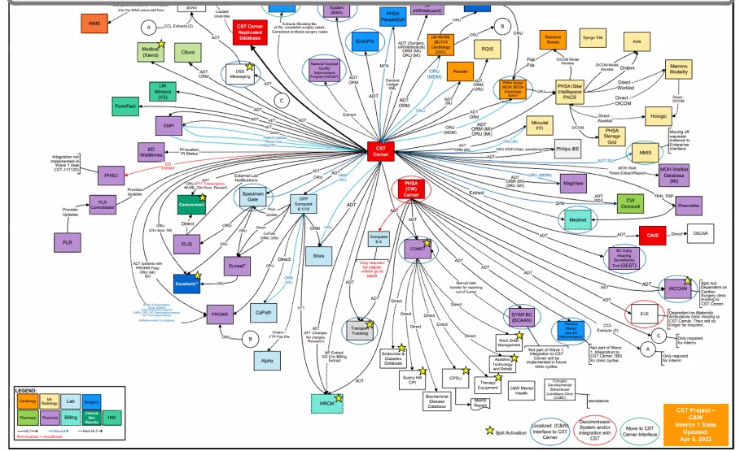
Interoperability in action : INTERFACE MAP
Source: CST Project Team, 2022

Slide 45
Lecture 5: Design, BUILD & DEPLOY HL7 Interfaces: Practical Approach

Slide 46
The 10-step process
Define Interface Purpose and Goal/s
Functional Design
Technical Design
Interface Specifications
Message Formats and Transport Protocols​
Error Handling and Security​
Configure the sending and receiving systems
Send Message : Generate & Validate HL7 Message
Receive Message : Confirm Acknowledge Receipt and Processing
Deploy Interface in Production

Slide 47
Hl7 Interface design & deployment process
Define Interface Purpose and Goal/s
Technical Design
Outlines the specific goal of the interface, such as connecting two systems to send and receive various HL7 messages like ADT, ORM, MFN, and DFT.
Describes how the functional design translates into technical implementation, usually in an integration engine Visual diagrams showing the implementation flow and architecture.
01
02
03
04
Functional Design
Interface Specifications
How the solution meets requirements, detailing any complex logic required to manipulate data between systems. High-level depiction of message flows specific to the systems involved
References to specific vendor interface specifications, which are critical for understanding how to construct and parse messages for each system involved.

Slide 48
Hl7 Interface design & deployment process
Message Formats and Transport Protocols​
Configure the sending and receiving systems
Details the format of HL7 messages, ensuring both systems are compatible or describing necessary transformations. Documents the protocols used for message transport
This involves configuring the sending and receiving parameters, like IP addresses, port numbers, and communication protocols (e.g., MLLP). Align the EMR's data fields to the corresponding segments and fields of the HL7 message structure
05
06
07
08
Error Handling and Security​
Send Message : Generate & Validate HL7 Message
Procedures for dealing with message format errors or network communication issues. Details the security mechanisms for communications, including network and protocol security, and any message-level security required.
Initiate a secure connection between the sending and receiving systems using the predefined communication protocol. Ensure that acknowledgments (ACK) are received to confirm successful message delivery.

Slide 49
Hl7 Interface design & deployment process
Receive Message : Confirm Acknowledge Receipt and Processing
Validate that the Receiving system receives the message as expected sends back appropriate HL7 acknowledgments and updates patient accounts accordingly.
09
10
Deploy Interface in Production
Deploy the interface in the production environment and monitor the interface closely for the first few weeks to ensure it operates smoothly and troubleshoots any issues

Slide 50
Lecture 6: case scenario – how to IMPLEMENT an hl7 interface from scratch

Slide 51
Scenario: Implementing an HL7 Interface for Patient Account Updates
Background: A healthcare IT expert, Alex, has been tasked with developing an outbound interface from the hospital's EMR system to a third-party billing software.
The goal is to ensure that all patient account information is automatically updated in the billing system following any ADT (Admit, Discharge, Transfer) events in the EMR.

Slide 52
Steps for Alex to Create the Interface: (1 of 3)
Define Interface Purpose and Goal/s:
Alex meets with stakeholders from the hospital administration and the billing department to understand the exact requirements.
The purpose is outlined: to create an interface that sends ADT information from the EMR to the billing software to update patient accounts.
Functional Design:
Alex drafts a functional design document that includes a workflow diagram showing how ADT information will flow from the EMR to the billing system.
The design addresses how different ADT events (admissions, discharges, and transfers) trigger updates in the billing software.
Technical Design:
Alex develops a technical design that maps the functional requirements to specific technical solutions.
This includes selecting an integration engine and planning the transformation of data to the format required by the billing system.

Slide 53
Steps for Alex to Create the Interface: 2 of 3
4. Interface Specifications:
Detailed interface specifications are compiled, which include field mappings and trigger events for sending the HL7 messages.
5. Message Formats and Transport Protocols:
Alex confirms that the EMR and billing software can communicate using HL7 version 2.x messages over MLLP (Minimum Lower Layer Protocol) and that both systems are using TCP/IP for transport.
6. Error Handling and Security:
Strategies for handling message errors and ensuring secure data transfer are established. Alex decides on using TLS for encryption and plans for the interface to handle negative acknowledgments (NAKs) properly.

Slide 54
Steps for Alex to Create the Interface: (3 of 3)
7. Configure the Sending and Receiving Systems:
Alex works with the EMR's IT team to configure the system to generate HL7 ADT messages.
He then coordinates with the billing software's support team to configure their system to receive and process these messages.
8. Send Message: Generate & Validate HL7 Message:
Alex sets up a test environment to generate HL7 ADT messages from the EMR, ensuring they are properly formatted and contain all necessary information
9. Receive Message: Confirm Acknowledge Receipt and Processing:
Once the billing software receives the test messages, Alex confirms that it sends back appropriate HL7 acknowledgments and updates patient accounts accordingly.
10. Deploy Interface in Production:
After thorough testing, Alex deploys the interface in the production environment.
He monitors the interface closely for the first few weeks to ensure it operates smoothly and troubleshoots any issues that arise

Slide 55
The EVN (Event Type) segment indicates the type of event that triggered this message, in this case, an A01 event for patient admission.
The PID (Patient Identification) segment contains demographic information like the patient's name, date of birth, gender, address, and unique identifiers.
MSH|^~\&|EMRSystem|HospitalA|BillingSoftware|BillingDept|202312311015||ADT^A01|123456789|P|2.5||
EVN|A01|202312311015|||
PID|1||987654321^^^HospitalA^MR||Doe^John^Joseph^Mr.||19870710|M|||123 Care Street^^Anytown^CA^98765^USA||(123)456-7890|||S||123456789|876-54-3210||
PV1|1|I|U|||5555^Smith^John^D^Dr.^^^Dr.|6666^Williams^Sara^E^Dr.^^^Dr.|7777^Lee^Robert^A^Dr.^^^Dr.|MED||
GT1|1||Doe^John^Joseph^Mr.|123 Care Street^^Anytown^CA^98765^USA||(123)456-7890||19870710|M|||987654321|
IN1|1|PPO|PPO12345^Preferred Provider Org|||||123456|||Doe^John^Joseph^Mr.||-||||||||||||987654321|
The PV1 (Patient Visit) segment provides details about the patient's current visit, such as the patient class (inpatient or outpatient), attending doctor, and the department.
The GT1 (Guarantor) and IN1 (Insurance) segments include information about the guarantor and the patient’s insurance, which is essential for billing purposes.

Slide 56
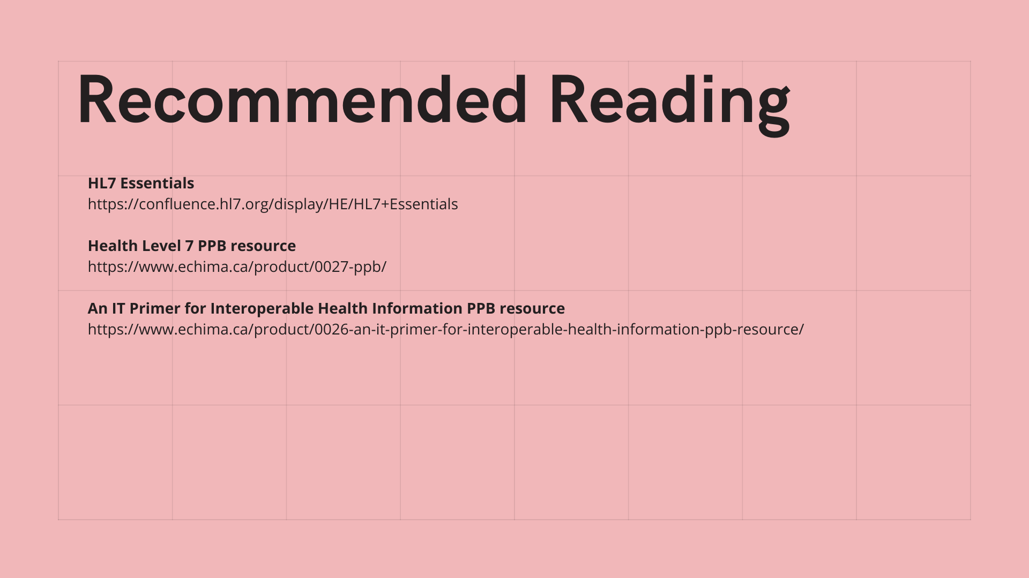

Slide 57
What if we did not have hl7
Increased Manual Work and Errors:
Without a standardized communication protocol, healthcare providers would rely more on manual processes for entering and sharing patient information. This increases the risk of errors and delays, as data might need to be re-entered multiple times across different systems.
Slower Communication:
Each department or healthcare entity might use different systems, leading to slower communication and coordination. Critical information may take longer to reach the relevant parties, potentially delaying patient care.
Inconsistent Data:
Without standardization, the same information could be represented differently across various systems, leading to inconsistencies and confusion. This can affect clinical decisions, billing, and overall patient management.
Decreased Quality of Care:
Delays and errors in patient information handling can lead to suboptimal clinical decisions, affecting the quality of care provided. In emergency situations, these delays can be particularly critical.

Slide 58
How will this knowledge help?
Clinicians
Understand how different health IT systems communicate, ensuring access to complete patient data across various care settings
Actively participate in the selection and implementation of EHR systems
Identify ways to streamline clinical workflows
Tech Professionals
Design, build and implement HL7 interfaces
Excellent career advance skill in health informatics

Slide 59
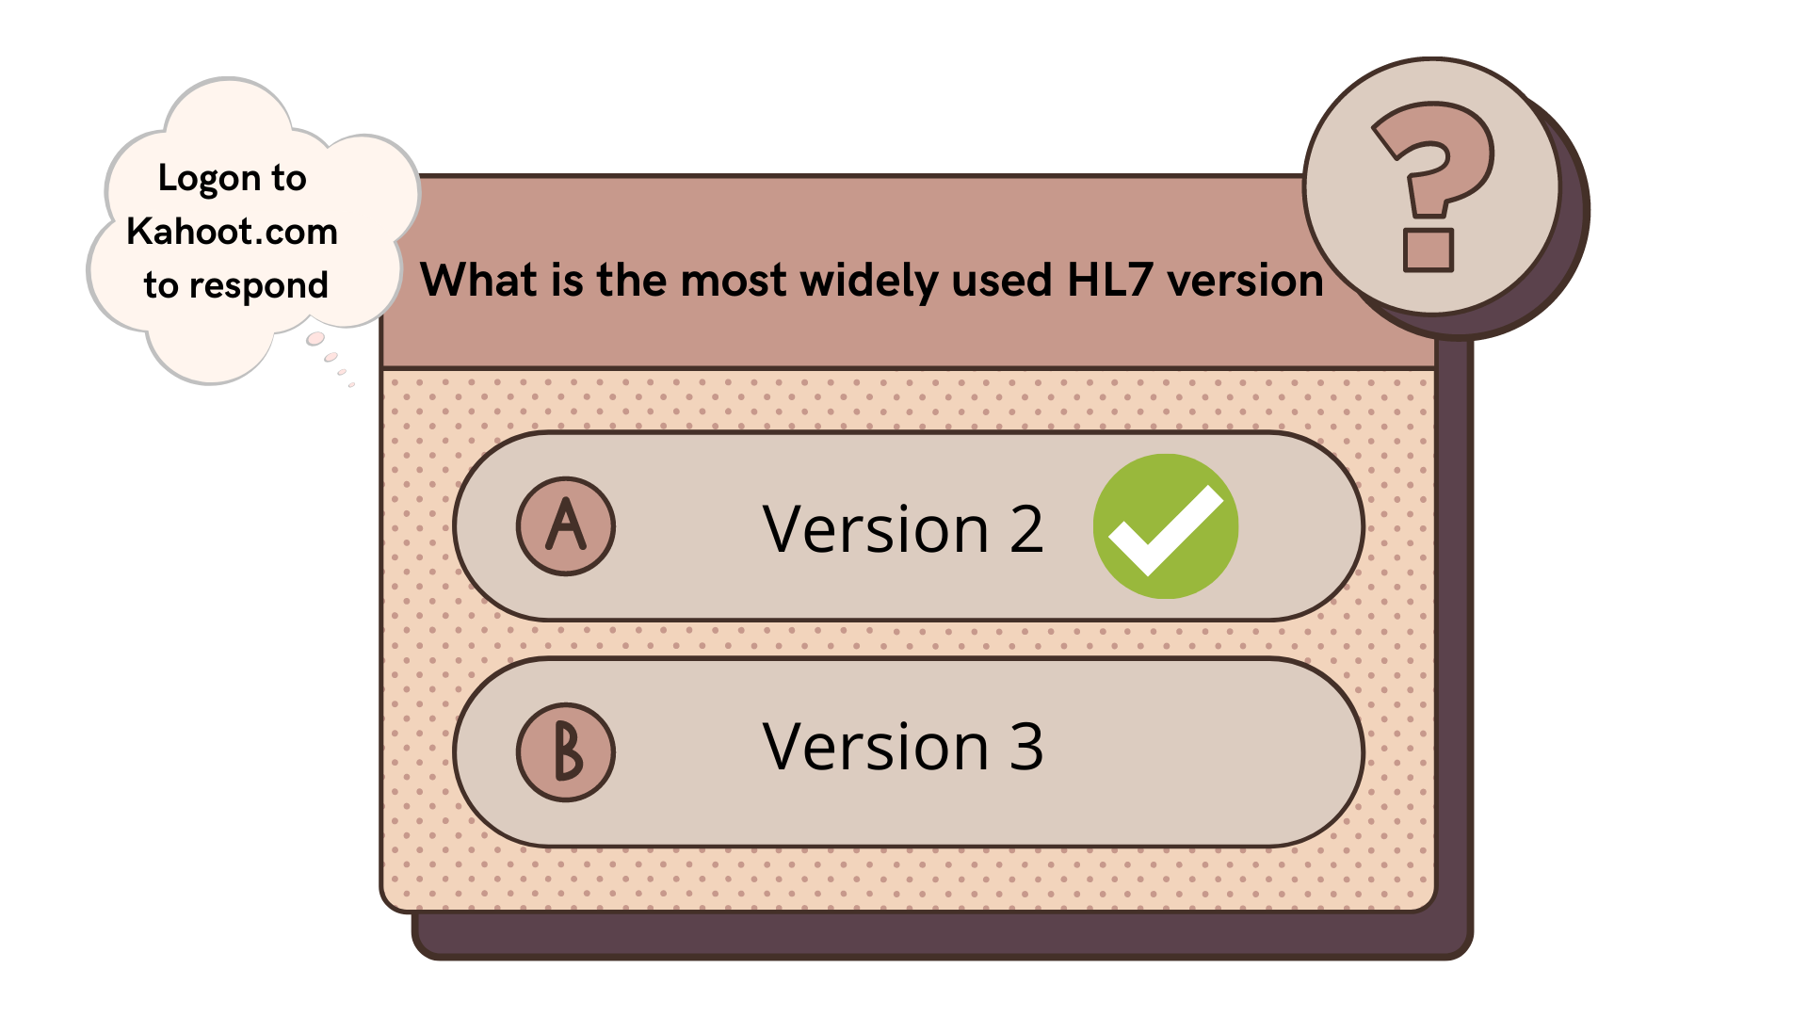

Slide 60
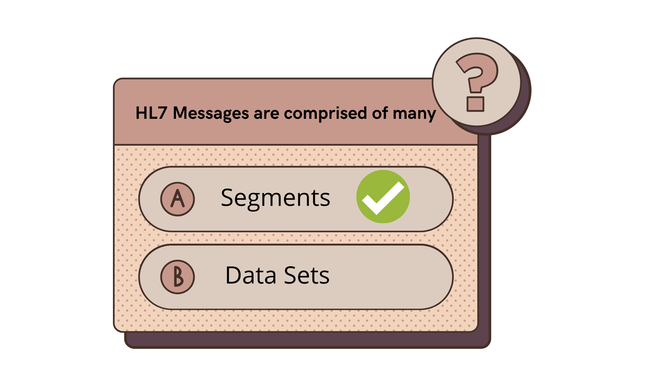

Slide 61
COURSE RECAP: What did we learn
Introduction to Healthcare Interoperability
What is Interoperability?
Importance of Data Exchange
Scenarios for Data Exchange
Challenges in Interoperability
Summary of Healthcare Interoperability
Q&A: Interoperability
Basics of HL7 Standards
What is HL7?
Purpose of HL7
Versions of HL7
HL7 in Action
Summary of HL7 Basics
Healthcare Interfaces
Understanding HL7 Message Structure
Reading an HL7 Message
Common Message Types
Implementing a HL7 Interface

Slide 62
APPENDIX

Slide 63
ADDITIONAL INFOrmation
HL7 also provides EHR profiles. These profiles outline the necessary functions and criteria for Electronic Health Records. In these profiles, you can see what functions may be necessary for a pharmacist, clinical researcher, dietitians, behavioral health expert, and others in an EHR.
EHR models promote the use of certain functionalities, such as those that standardize interfaces of Common Terminology Services, outline functions and criteria to create a standardized model of all EHR systems (also known as an EHR-System Functional Model—which we’ll discuss later),demonstrate how to transmit electronic prescriptions from inpatient to outpatient settings,and others.
HL7’s Implementation Guides provide guidance and support on how to implement and support existing HL7 standards.

Slide 64

ADDITIONAL INFOrmation
HL7’s Rules and References provide the technical specifications, structures and guidelines for software development, and information to support standards development.
Finally, HL7’s Education and Awareness section provides educational materials. Additionally, HL7 members and approved commenters can find current projects and Draft Standards for Trial Use(DTSUs).

Slide 65
HL7 Primary Standards- Clinical Document Architecture (CDA)
Specific to HL7 Version 3 is Clinical Document Architecture (CDA). CDA uses XML to standardize the structure and semantics of clinical documents for easy exchange between patients and providers.
According to CDA standards, clinical documents meet the following six characteristics:
Persistence
Stewardship
Potential for Authentication
Context
Wholeness
Human Readability

Slide 66
CDA Continued…
Examples include documents such as referrals, notes, treatment plans, reports, discharge summaries , admission documentation and physical exams.
CDA provides a framework for incremental semantic interoperability—meaning there is a range of complexity in CDA for interoperability customization.
An organization can choose whether they just want to use the minimum number of XML metadata fields or optionally include or increase the number of structured parts for software processing.
The primary objectives of the CDA standard include:
...giving priority to the delivery of patient care, allowing cost effective implementation across as wide a spectrum of systems as possible, supporting exchange of human-readable documents between users including those with different levels of technical sophistication, promoting longevity of all information encoded according to this architecture, and enabling a wide range of post-exchange processing applications.

